Slide 1



VN Habit Tracker
VHT
Supervisor: - Lai Duc Hung
Members: - Luu Thanh Dat - Leader - Pham Thanh Tung

Slide 2


01
Introduction
02
Issues
03
CONTENT
Idea & Solution
04
Outcome
05
Future Plan
06
Q & A

Slide 3

1. Introduction
What?
Why?
How?

Slide 4



1. Introduction
Children
What?
Why?
How?

Slide 5



1. Introduction
Student
What?
Why?
How?

Slide 6



1. Introduction
Adult
What?
Why?
How?

Slide 7

1. Introduction
What?
Why?
How?

Slide 8






1. Introduction
What?
Why?
How?

Slide 9


1. Introduction
What?
Why?
How?

Slide 10






2. Issues
z

Slide 11

2. Issues
z

Slide 12



2. Issues

Slide 13
2. Issues

Slide 14








2. Issues

Slide 15

3. Idea & Solution
What?
Why?
How?

Slide 16
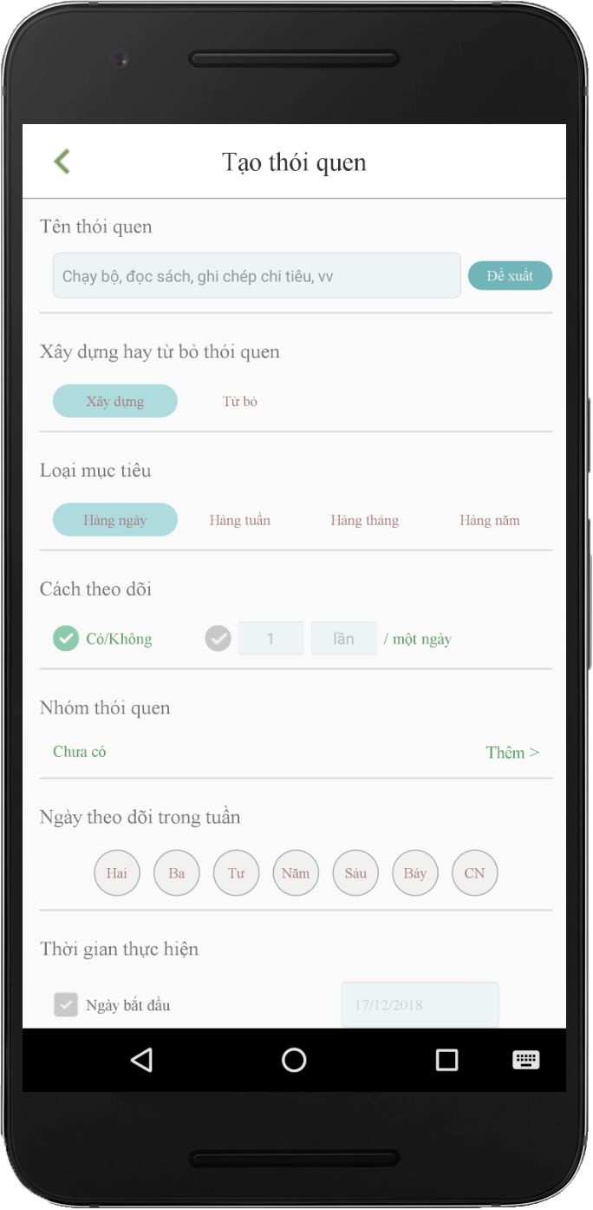

Create Habit
Business Logic
Algorithm
..v..v..

Slide 17
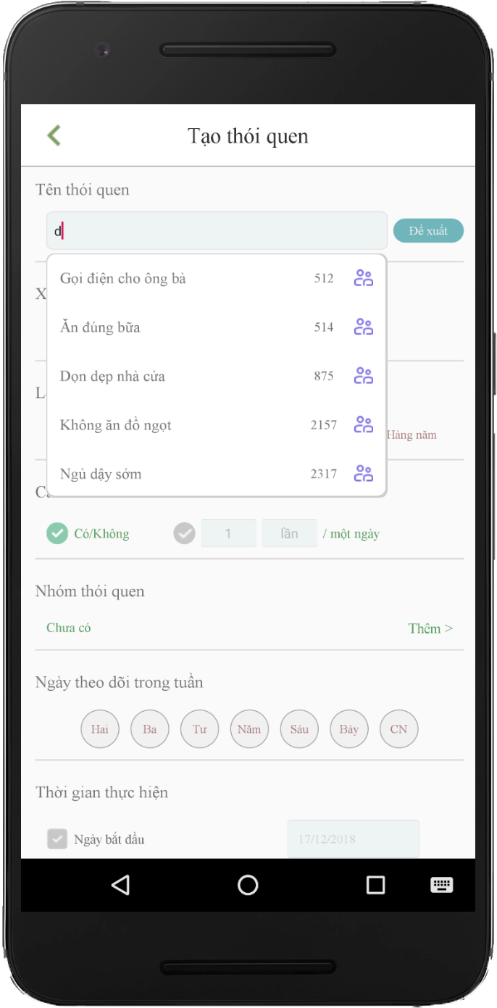
Create Habit
Business Logic
Algorithm
..v..v..

Slide 18
Suggest Habit
Business Logic
Algorithm
..v..v..

Slide 19
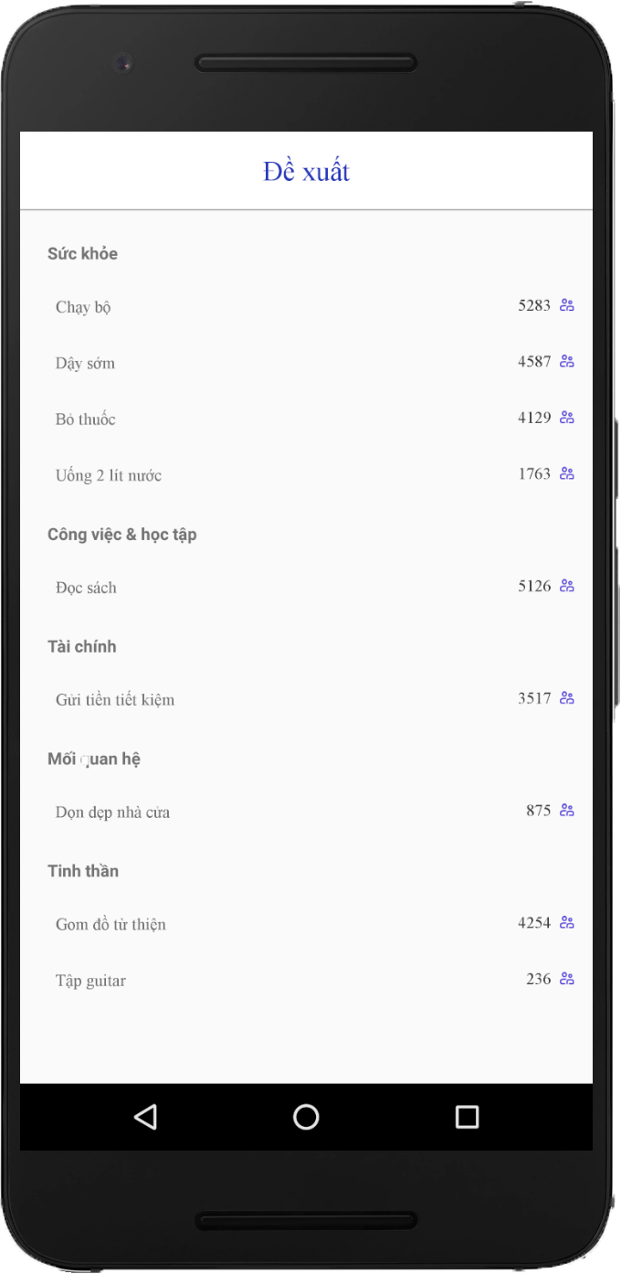
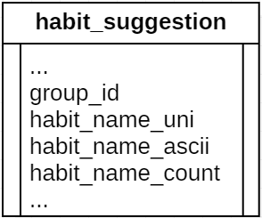
Suggest Habit
compare
have
+ 1
not have
Add New

Slide 20
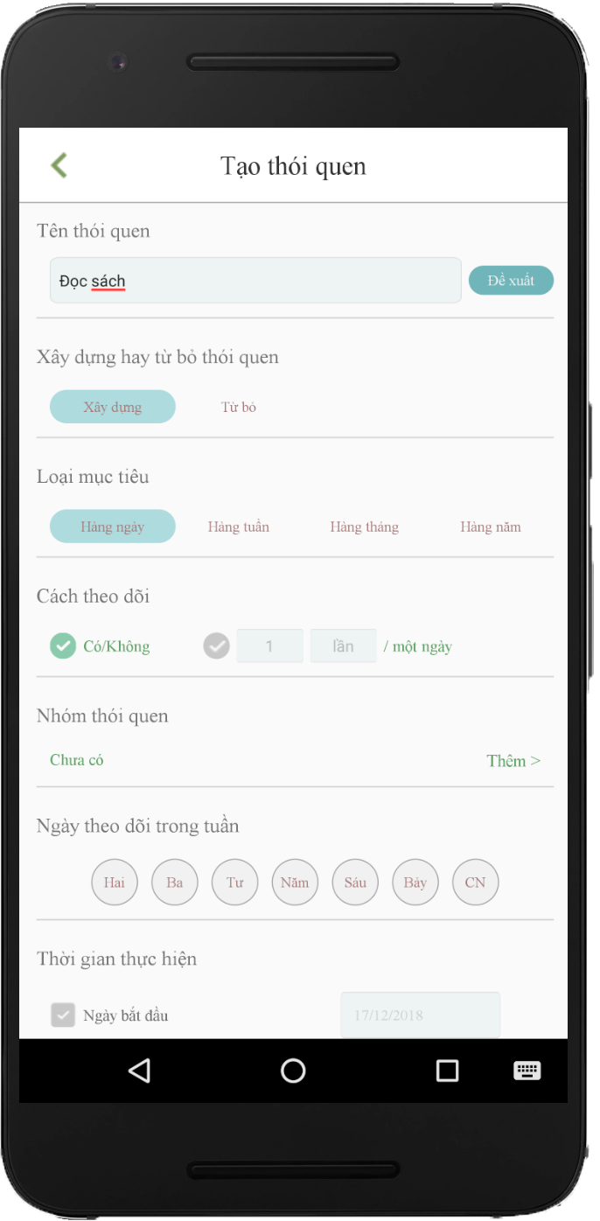
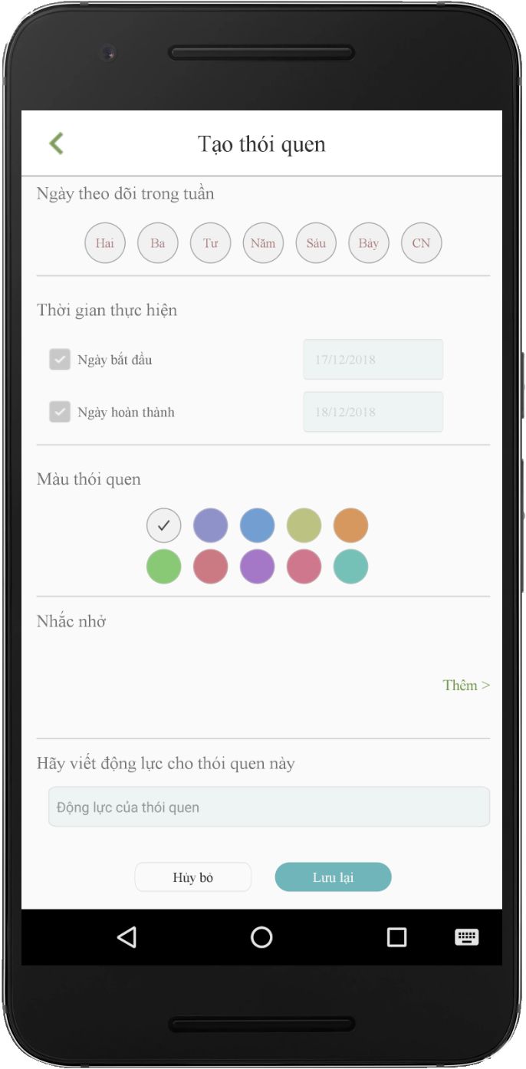
Create Habit
Build/quit
Daily/weekly/monthly/yearly
Yes/no - countable
Group
Day in week
Set time goal
Color
Reminders
Note/ motivation

Slide 21

3. Idea & Solution

Slide 22

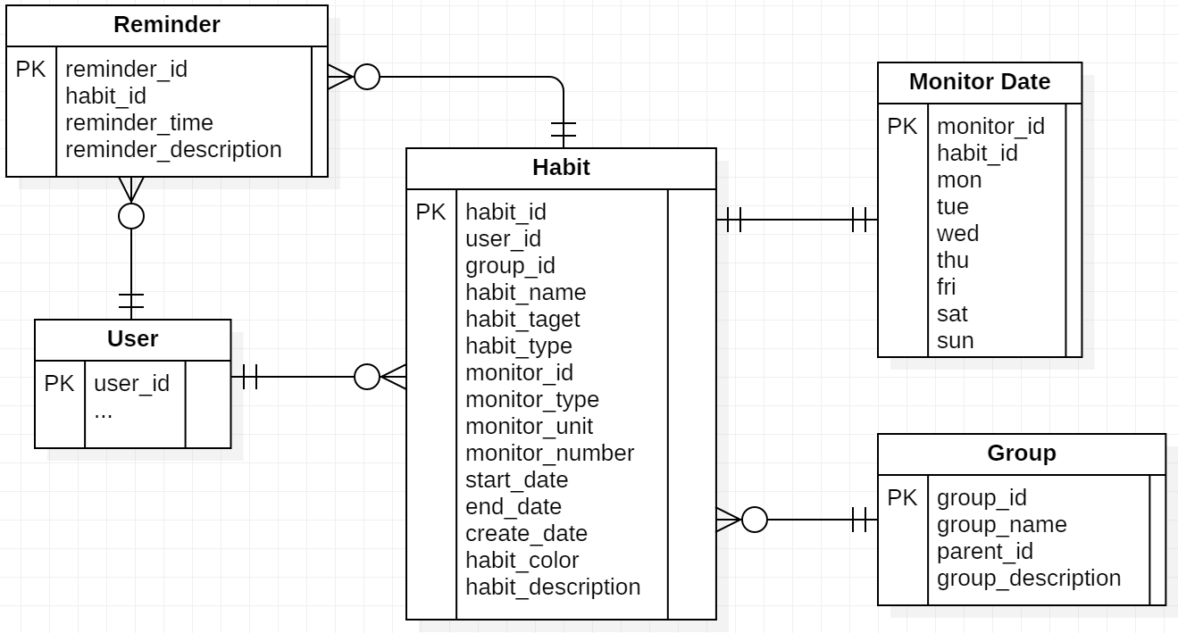
3. Idea & Solution
How?

Slide 23
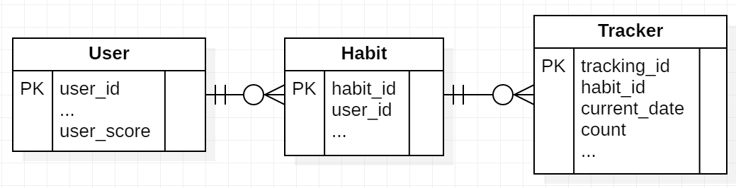
3. Idea & Solution
How?

Slide 24



3. Idea & Solution
$f\left(x\right)=t+d\left(x\right)+c\left(x\right)$ $∀x ∈\{1,2,3\}$

Slide 25
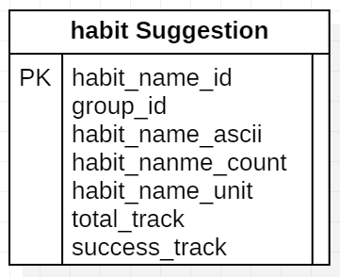
3. Idea & Solution
build/quit
countable
Success
Daily
Weekly
Monthly
Yearly
yes/no

Slide 26
3. Idea & Solution
$f\left(x\right)=t+d\left(x\right)+c\left(x\right)$ $∀x ∈\{1,2,3\}$

Slide 27

3. Idea & Solution
Daily
Weekly
Monthly
Yearly
n = 2(n-1) + (n – 2)
+ score
7 days: +2
30 days: +4
60 days: +8
180 days: +18
360 days: +32
Level 1 – 3: easy
Level 4 – 6: medium
Level > 6: hard

Slide 28
3. Idea & Solution
$f\left(x\right)=t+d\left(x\right)+c\left(x\right)$ $∀x ∈\{1,2,3\}$

Slide 29
3. Idea & Solution

Slide 30










4. Outcome

Slide 31













5. Future Plan

Slide 32



Thanks for listening!

